Slide 1
2006 IPCC Guidelines for National Greenhouse Gas Inventories: Waste Sector
Africa Regional Workshop on the Building of Sustainable National
Greenhouse Gas Inventory Management Systems, and the Use of the 2006
IPCC Guidelines for National Greenhouse Gas Inventories
Swakopmund, Namibia
24-28 April 2017
Baasansuren Jamsranjav, IPCC TFI TSU

Slide 2
Outline
Introduction
Major Developments in the 2006 IPCC Guidelines
Methods for Estimation of Greenhouse Gas Emissions from Waste Sector
  Solid waste disposal (4A)
  Biological treatment of solid waste (4B)
  Incineration and open burning of waste (4C)
  Wastewater treatment and discharge (4D)
Waste Data

Slide 3
Introduction
Volume 5 (Waste) provides methodological guidance for estimation of CO₂, CH₄ and N₂O emissions from following categories:
  Solid waste disposal (4A)
  Biological treatment of solid waste (4B)
  Incineration and open burning of waste (4C)
  Wastewater treatment and discharge (4D)
Typically, CH₄ emissions from solid waste disposal sites (SWDS) are the largest source in the Waste sector
Biogenic CO₂ emissions are not included in the Waste sector
All greenhouse gas emissions from waste-to-energy should be estimated and reported under the Energy sector

Slide 4
Major Developments in the 2006 IPCC Guidelines:
Waste Sector
Improved accuracy
  Updated methods and improved default values
  The previous Tier 1 method is replaced by a first order decay (FOD) method including a simple spreadsheet model (IPCC Waste Model)
  http://www.ipcc-nggip.iges.or.jp/public/2006gl/vol5.html
More complete:
  Guidance is given on more sources
    Biological treatment of solid waste
    Open burning of waste
  Inclusion of method to estimate N₂O emissions from advanced wastewater treatment plants

Slide 5
Solid Waste Disposal on Land: CH₄ Generation
Decomposition of organic components in waste under anaerobic environment
Waste disposal practices vary in placement of waste and management of the site, etc.
  Methane correction factor (MCF) accounts for the fact that unmanaged SWDS produce less CH₄ from a given amount of waste than anaerobic managed SWDS
Methodology for estimating CH₄ emissions from SWDS is based on the FOD method
  Degradable organic component in waste at landfills decays slowly throughout a few decades during which significant amount of CH₄ and CO₂ are formed (some N₂O, NMVOCs, NO_{x} and CO)
  Key parameters include half-life, and either methane generation potential (Lo) or DOC content in waste and the fraction of DOC which decomposes (DOCf)
  A simple spreadsheet model is provided to assist countries in using the FOD method
The FOD method requires data for historical disposals of waste
  The 2006 Guidelines provide guidance on how to estimate historical waste disposal data

Slide 6
Solid Waste Disposal on Land: CH₄ Emissions
CH₄ emissions in year T from SWDS (Gg)
T : inventory year
X : waste category or type/material
R_{T} : recovered CH₄ in year T, Gg
OX_{T} : oxidation factor in year T, fraction
CH₄ generated is estimated on the basis of the amount of Decomposable Degradable Organic Carbon (DDOCm) which is the part of the organic carbon that will degrade under the anaerobic conditions in SWDS

Slide 7
FOD Spreadsheet Model (IPCC Waste Model)
Most useful to Tier 1, but can be adapted for use with all tiers
  Estimation of actual emissions of CH₄
Two options for emission estimation from municipal solid waste (MSW) depending on data availability
  Waste composition
  Bulk waste
Historical data on solid waste disposal
  Amount of MSW can be estimated from population and per capita waste generation data (Tier1)
Allows to define a delay time
  Period between deposition of the waste and the start of CH₄ generation

Slide 8
FOD Spreadsheet Model (IPCC Waste Model)
Selection of appropriate region in the “Parameters” sheet will adjust the IPCC defaults in other sheets
Allows selection of DOC and methane generation rate constant (k) for modeling by waste composition or bulk waste options
Allows selection of appropriate IPCC default k value for the selected climate zone
The input parameters are entered into cells colored yellow in the worksheets with yellow colored tabs. Other sheets-calculated automatically
Calculates the amount of CH₄ generated from each waste component on a different worksheet

Slide 9
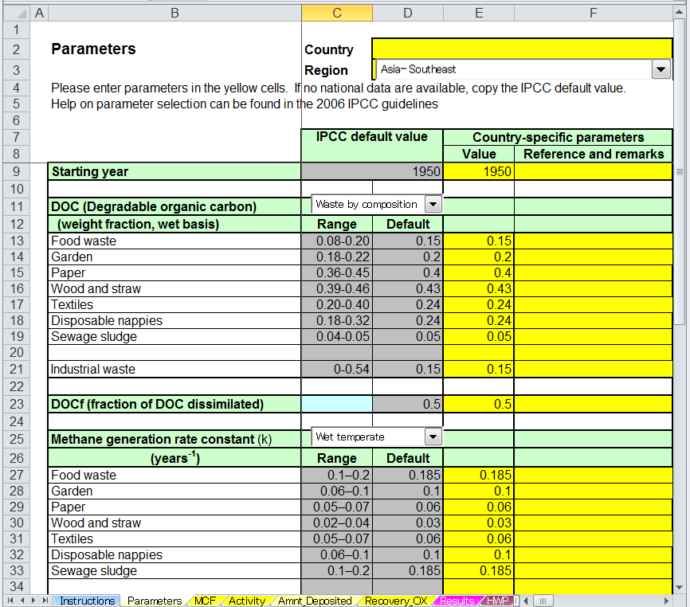

Slide 10
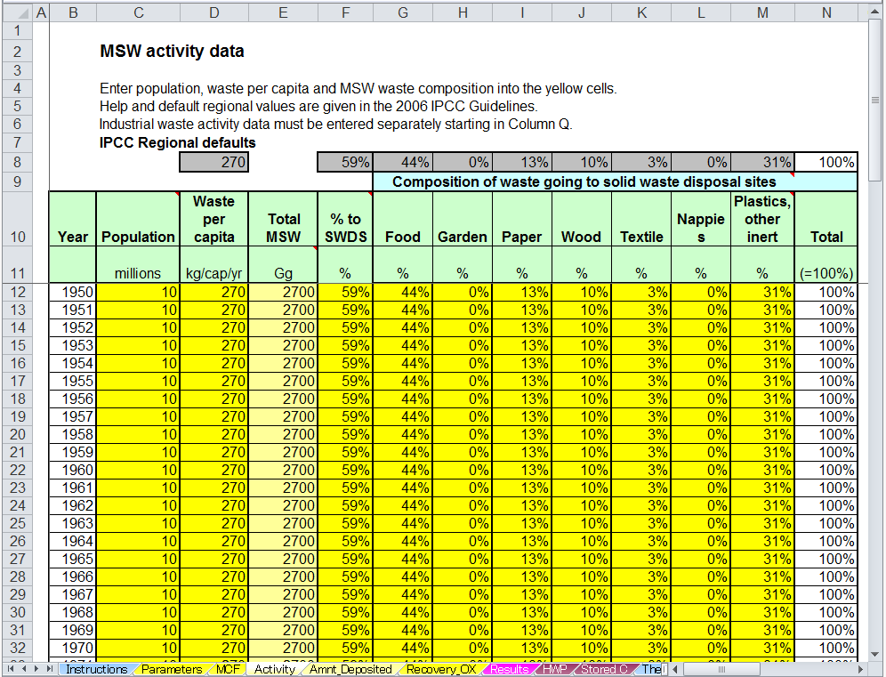

Slide 11
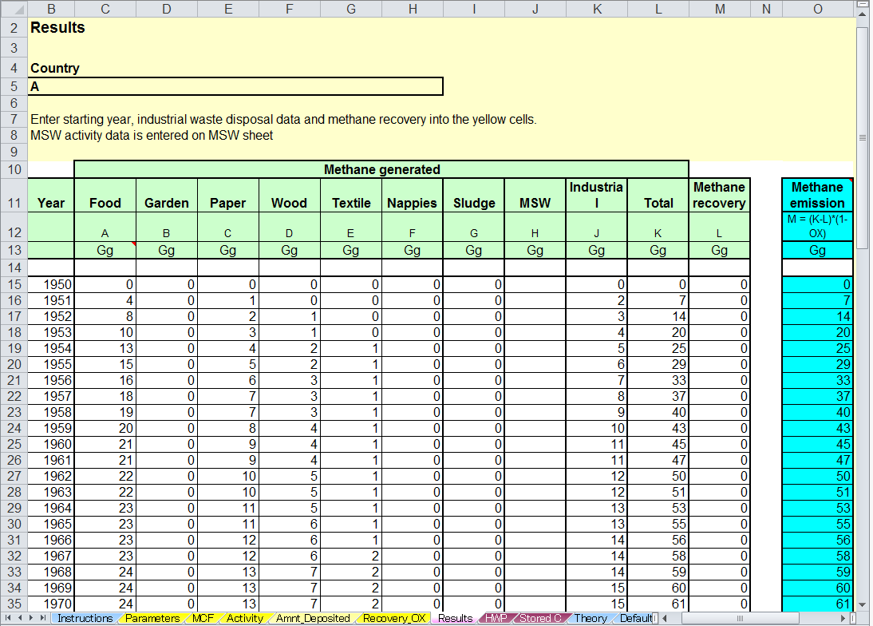

Slide 12
Biological Treatment of Solid Waste
Composting and anaerobic digestion of organic waste (food waste, garden and park waste etc.)
  reduced volume in the waste material
  stabilisation of the waste
  production of biogas for energy use
  end product can be recycled as a fertilizer or soil amendment
Composting
  large fraction of DOC in waste is converted to CO₂
  CH₄ and N₂O can both be formed during composting
Anaerobic digestion
  Biogas (CH₄ and CO₂)
  N₂O is assumed to be negligible

Slide 13
Biological Treatment of Solid waste: CH₄ Emissions
Default method for estimation of CH₄ emissions:
CH₄ Emissions: total CH₄ emissions in inventory year, Gg CH₄
M_{i} : mass of organic waste treated by biological treatment type i, Gg
  EF_{i} : emission factor for treatment i, g CH₄/kg waste treated
i : composting or anaerobic digestion
R : total amount of CH₄ recovered in inventory year, Gg CH₄. If the recovered gas is flared, the emissions should be reported in Waste Sector

Slide 14
Biological Treatment of Solid Waste: N₂O Emissions
Default method for estimation of N₂O emissions:
N₂O Emissions: total N₂O emissions in inventory year, Gg N₂O
M_{i} : mass of organic waste treated by biological treatment type i, Gg
EF_{i} : emission factor for treatment i, g N₂O/kg waste treated
i : composting or anaerobic digestion

Slide 15
Biological Treatment of Solid Waste:
Choice of Methods, AD and EFs
Methodological tiers for estimation of CH₄ and N₂O emissions
  Tier 1: Tier 1 uses the IPCC default emission factors
  Tier 2: Country-specific EFs based on representative measurements
  Tier 3: Facility or site-specific measurements data (on-line or periodic)
When national data are not available
  Regional default values for AD and EFs are given in Chapter 2 and 4
It is good practice that countries use national, annually or periodically collected data, where available
  National statistics
  Data from municipal or regional authorities responsible for waste management, or from waste management companies

Slide 16
Incineration and Open Burning of Waste: CO₂ Emissions
Based on the total amount of waste combusted:
CO₂ Emissions: CO₂ emissions in inventory year, Gg/yr
SW_{i} : total amount of solid waste of type i (wet weight) incinerated or open-burned, Gg/yr
dm_{i} : dry matter content in the waste (wet weight) incinerated or open-burned, (fraction)
CF_{i} : fraction of carbon in the dry matter (total carbon content), (fraction)
FCF_{i} : fraction of fossil carbon in the total carbon, (fraction)
OF_{i} : oxidation factor, (fraction)
44/12 : conversion factor from C to CO₂
i : type of waste incinerated/open-burned such as MSW, industrial solid waste (ISW), sewage sludge, hazardous waste, clinical waste, etc.
Estimation of the amount of fossil carbon is the most important factor determining the CO₂ emissions as only CO₂ emissions of fossil origin (e.g., plastics, certain textiles, rubber, liquid solvents, and waste oil) should be included

Slide 17
Incineration and Open Burning of Waste: CO₂ Emissions
Emissions from municipal solid waste:
CO₂ Emissions: CO₂ emissions in inventory year, Gg/yr
MSW : total amount of municipal solid waste as wet weight incinerated or open-burned, Gg/yr
WF_{j} : fraction of waste type/material of component j in the MSW (as wet weight incinerated or open-burned)
dm_{j} : dry matter content in the component j of the MSW incinerated or open-burned, (fraction)
CF_{j} : fraction of carbon in the dry matter (i.e., carbon content) of component j
FCF_{j} : fraction of fossil carbon in the total carbon of component j
OF_{j} : oxidation factor, (fraction)
44/12 : conversion factor from C to CO₂
j : component of the MSW incinerated/open-burned such as paper/cardboard, textiles, food waste, wood, garden (yard) and park waste, disposable nappies, rubber and leather, plastics, metal, glass, other inert waste

Slide 18
Incineration and Open Burning of Waste: CH₄ Emissions
CH₄ emissions result from incomplete combustion of waste and can be affected by temperature, residence time, and air to waste ratio
CH₄ Emissions: CH₄ emissions in inventory year, Gg/yr
IW_{i} : amount of solid waste of type i incinerated or open-burned, Gg/yr
EF_{i} : aggregate CH₄ emission factor, kg CH₄/Gg of waste
10⁻⁶ : conversion factor from kilogram to gigagram
i : category or type of waste incinerated/open-burned (MSW, ISW, hazardous waste,
clinical waste, sewage sludge, etc.)
The amount and composition of waste should be consistent with the activity data used for estimating CO₂ and N₂O emissions from incineration/open burning

Slide 19
Incineration and Open Burning of Waste: N₂O Emissions
The N₂O emissions are mainly determined by technology, combustion temperature (emitted at relatively low combustion temperatures 500-950ºC) and waste composition
N₂O Emissions: N₂O emissions in inventory year, Gg/yr
IW_{i} : amount of incinerated/open-burned waste of type i , Gg/yr
EF_{i} : N₂O emission factor (kg N₂O/Gg of waste) for waste of type i
10⁻⁶ : conversion from kilogram to gigagram
i : category or type of waste incinerated/open-burned (MSW, ISW, hazardous waste,
clinical waste, sewage sludge, etc.)

Slide 20
Amount of Waste Open-burned
Statistics may not be available. Where the data on waste amount are not available, total amount of MSW open-burned can be estimated
MSW_{B} : Total amount of municipal solid waste open-burned, Gg/yr
P : population (capita)
P_{frac} : fraction of population burning waste, (fraction)
MSW_{P} : per capita waste generation, kg waste/capita/day
B_{frac} : fraction of the waste amount that is burned relative to the total amount of waste treated
365 : number of days by year
10⁻⁶ : conversion factor from kilogram to gigagram

Slide 21
Incineration of Fossil Liquid Waste: CO₂ Emissions
Fossil liquid waste - industrial and municipal residues, based on mineral oil, natural gas or other fossil fuels. It includes waste formerly used as solvents and lubricants
If, fossil liquid waste is not included in other types of waste (e.g., industrial waste, hazardous waste), the emissions need to be calculated separately
CO₂ Emissions: CO₂ emissions from incineration of fossil liquid waste, Gg
AL_{i} : amount of incinerated fossil liquid waste type i, Gg
CL_{i} : carbon content of fossil liquid waste type i, (fraction)
OF_{i} : oxidation factor for fossil liquid waste type i, (fraction)
44/12 : conversion factor from C to CO₂

Slide 22
Incineration and Open Burning of Waste: Choice of Methods, AD and EF/Parameters
Methodological tiers for estimation of CO₂ emissions:
  Tier 1: Default AD (amount, composition of waste incinerated/open-burned) and default parameters. The method is used when the emissions from incineration/open burning are not a key category
  Tier 2: Country-specific AD, default and some country-specific parameters
  Tier 3: Plant-/management-specific data
Methodological tiers for estimation of CH₄ and N₂O emissions
  Tier 1: Default AD (amount, composition of waste incinerated/open-burned) and EFs
  Tier 2: Country-specific AD and EFs by waste type, technology or management practice
  Tier 3: Plant-/management-specific data (e.g. flue gas concentrations for N₂O emissions)
Default values are provided in Chapter 2 and 5

Slide 23
Wastewater Treatment and Discharge
Wastewater (domestic, commercial and industrial) may be treated on site (uncollected), sewered to a centralized plant (collected) or disposed untreated
Treatment and disposal of wastewater produce GHGs such as CO₂, CH₄ and N₂O
  CO₂ is of biogenic origin and not included
  N₂O emissions from sludge and wastewater spread on agricultural land are considered in AFOLU sector
Sludge produced in wastewater treatment is treated further. The CH₄ emissions from sludge sent to landfills, incinerated or used in agriculture are not included in this category

Slide 24
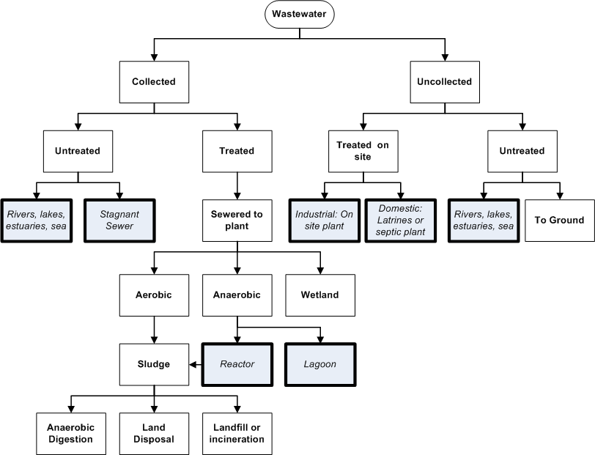
Wastewater Treatment Systems and Discharge Pathways

Slide 25
Wastewater Treatment and Discharge: CH₄ Emissions
CH₄ production depends primarily on the amount of degradable organic material in the wastewater, the temperature and the type of treatment system.
Common parameters used to measure the organic component of the wastewater :
  Biochemical Oxygen Demand (BOD): amount of carbon that is aerobically biodegradable
  Chemical Oxygen Demand (COD): total organic material available for chemical oxidation
Methodological tiers for estimation of CH₄ emissions:
  Tier 1 method applies default values for EFs (B_{o}, MCF, etc.) and AD
  Tier 2 method allows for incorporation of a country specific EF and AD
  Tier 3 method is a country specific method with measurements or other bottom-up data
CH₄ generated can be recovered and combusted in a flare or energy device.
  The flared or recovered for energy use should be subtracted from total emissions
  CH₄ recovery for energy generation should be reported in the Energy Sector

Slide 26
Domestic Wastewater Treatment: CH₄ Emissions
Total CH₄ emissions from domestic wastewater:
CH₄ Emissions: CH₄ emissions in inventory year, kg CH₄/yr
TOW : total organics in wastewater in inventory year, kg BOD/yr
S : organic component removed as sludge in inventory year, kg BOD/yr
U_{i}: fraction of population in income group i in inventory year
T_{i,j} : degree of utilisation of treatment/discharge pathway or system, j, for each income group fraction i in inventory year
i : income group: rural, urban high income and urban low income
j : each treatment/discharge pathway or system
EF_{j} : emission factor, kg CH₄ / kg BOD
R : amount of CH₄ recovered in inventory year, kg CH₄/yr

Slide 27
Domestic Wastewater Treatment: CH₄ Emissions
Activity data is the total amount of organically degradable material in the wastewater (TOW).
TOW : total organics in wastewater in inventory year, kg BOD/yr
P : country population in inventory year, (person)
BOD : country-specific per capita BOD in inventory year, g/person/day
0.001 : conversion from grams BOD to kg BOD
I : correction factor for additional industrial BOD discharged into sewers (for collected the default is 1.25, for uncollected the default is 1.00)

Slide 28
Domestic Wastewater: CH₄ Emissions
Emission factor for each domestic wastewater treatment/discharge pathway or system
EF_{j} : emission factor, kg CH₄ / kg BOD
j : each treatment/discharge pathway or system
B_{o} : maximum CH₄ producing capacity, kg CH₄/kg BOD
MCF_{j} : CH₄ correction factor (fraction) and indicates the degree to which the system is anaerobic

Slide 29
Industrial Wastewater: CH₄ Emissions
Industrial wastewater may be treated on-site or released into domestic sewer systems
The CH₄ emissions from industrial wastewater treatment (on-site):
CH₄ Emissions : CH₄ emissions in inventory year, kg CH₄/yr
TOW_{i} : total organically degradable material in wastewater from industry i in inventory year, kg COD/yr
i : industrial sector
S_{i} : organic component removed as sludge in inventory year, kg COD/yr
EF_{i} : emission factor for industry i, kg CH₄/kg COD for treatment/discharge pathway or systems. If more than one treatment practice is used in an industry this factor would need to be a weighted average.
R_{i} : amount of CH₄ recovered in inventory year, kg CH₄/yr

Slide 30
Industrial Wastewater: CH₄ Emissions
Emission factor for each treatment/discharge pathway/systems
EF_{j} : emission factor, kg CH4 / kg COD
j : each treatment/discharge pathway or system
B_{o} : maximum CH₄ producing capacity, kg CH₄/kg COD
MCF_{j} : CH₄ correction factor (fraction)

Slide 31
Industrial Wastewater: CH₄ Emissions
Activity data is the amount of organically degradable material in the wastewater (TOW):
TOW_{i} : total organically degradable material in wastewater for industry i, kg COD/yr
i : industrial sector
P_{i} : total industrial product for industrial sector i, t/yr
W_{i} : wastewater generated, m³/t product
COD_{i} : chemical oxygen demand (industrial degradable organic component in wastewater),
kg COD/m³

Slide 32
Wastewater treatment and discharge: N₂O Emissions
The N₂O emissions are associated with the degradation of nitrogen components in the wastewater (e.g., urea, nitrate and protein)
The N₂O emissions can occur as direct emissions from treatment plants or from indirect emissions from wastewater after disposal of effluent into waterways, lakes or the sea
  After treated at wastewater treatment plants, treated effluent is typically discharged to a receiving water environment (e.g., river, lake, estuary, etc.).
  Centralized wastewater treatment systems may include processes for removing nitrogen compounds. The direct emissions from nitrification and denitrification at wastewater treatment plants may be considered as a minor source.
The N₂O may be generated during
  Nitrification: aerobic process converting ammonia and other nitrogen compounds into nitrate (NO₃⁻)
  Denitrification: biological conversion of NO₃⁻ into dinitrogen gas (N₂) under anoxic environment
The emissions from industrial sources are believed to be insignificant compared to emissions from domestic wastewater

Slide 33
Domestic Wastewater: N₂O Emissions
Indirect N₂O emissions from wastewater effluent discharged into aquatic environments
N₂O Emissions : N₂O emissions in inventory year, kg N₂O/yr
N _{EFFLUENT} : nitrogen in the effluent discharged to aquatic environments, kg N/yr
EF_{EFFLUENT} : emission factor for N₂O emissions from discharged to wastewater, kg N₂O-N/kg N
44/28 : conversion of kg N₂O-N into kg N₂O.

Slide 34
Domestic Wastewater: N₂O Emissions
Total N in the effluent
N_{EFFLUENT} : total annual amount of nitrogen in the wastewater effluent, kg N/yr
P : human population
Protein : annual per capita protein consumption, kg/person/yr
F_{NPR} : fraction of nitrogen in protein (default = 0.16, kg N/kg protein)
F_{NON-CON} : factor for non-consumed protein added to the wastewater
F_{IND-COM} : factor for industrial and commercial co-discharged protein into the sewer system
N_{SLUDGE} : nitrogen removed with sludge (default = zero), kg N/yr

Slide 35
Domestic Wastewater: N₂O Emissions
Emissions from advanced centralised wastewater treatment plants
N₂O_{PLANTS} : total N₂O emissions from plants in inventory year, kg N₂O/yr
P : human population
T_{PLANT} : degree of utilization of modern, centralized WWT plants, %
F_{IND-COMM} : fraction of industrial and commercial co-discharged protein (default = 1.25)
EF_{PLANT} : emission factor, 3.2 g N₂O/person/year
To include N₂O emissions from plants, the amount of nitrogen associated with these emissions (N_{WWT}) must be subtracted from the N_{EFFLUENT}.

Slide 36
Waste Data
Collection of data is a fundamental part of inventory compilation. Chapter 2 of Volume 1 gives general guidance on data collection
Tier 1 methods are designed to use readily available national or international statistics in combination with default EFs/parameters
If there are no country-specific data, then IPCC default values and data from other sources can be used. However, need to assess the applicability of the data to national circumstances
It is preferable to use national data, however waste data covering all waste types and treatment techniques may not be available
Chapter 2 of Volume 5 provides default data on waste generation, management and composition
IPCC Emission Factor Database (EFDB) contains emission factors and other parameters with background technical information that can be used for estimation of GHG emissions and removals (http://www.ipcc-nggip.iges.or.jp/EFDB/main.php)

Slide 37
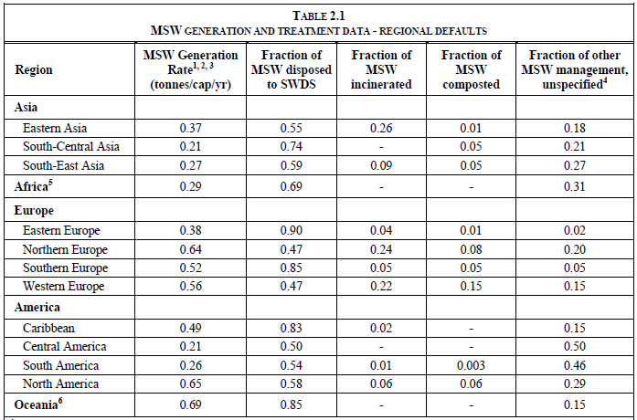

Slide 38
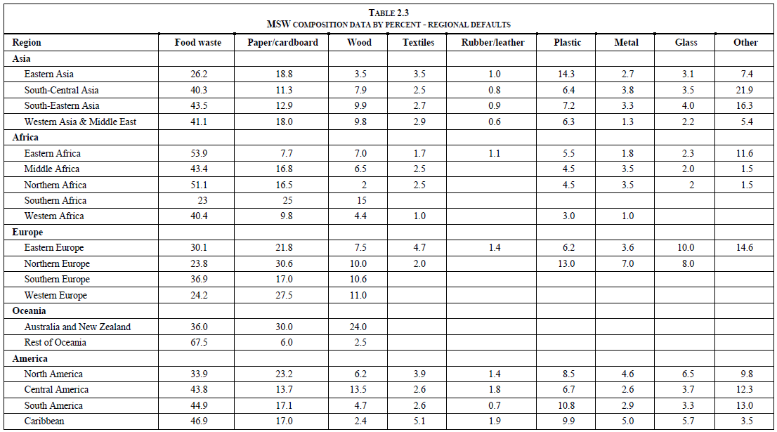

Slide 39
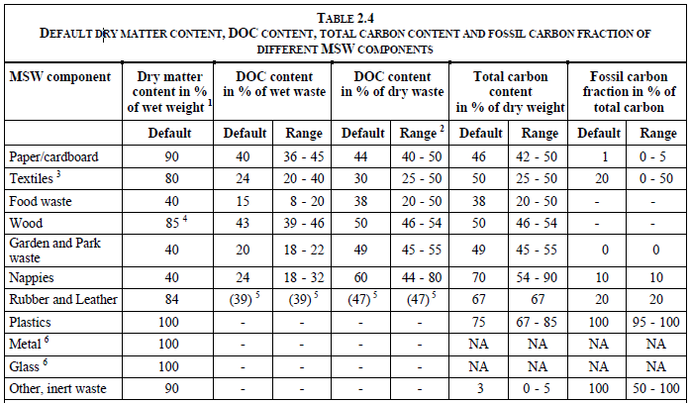

Slide 40
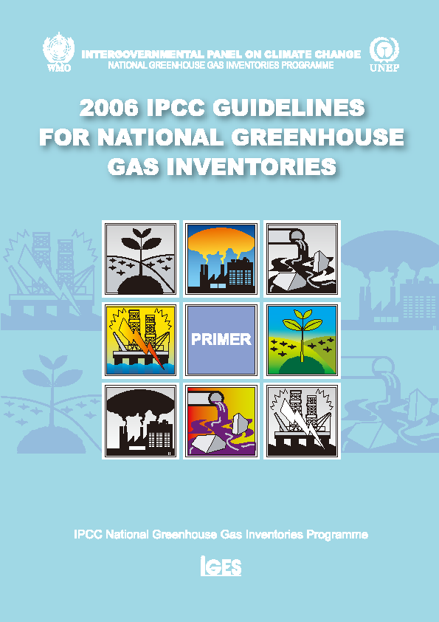
Thank you
Guidelines in all UN languages
can be downloaded from
http://www.ipcc-nggip.iges.or.jp
Diagrams © IPCC Except where noted otherwise

