Slide 1







Industrial Processes and Product Use (IPPU)
Africa Regional Workshop on the Building of Sustainable National
Greenhouse Gas Inventory Management Systems, and
the use of the 2006 IPCC Guidelines for National Greenhouse Gas Inventories
24-28 April 2017, Swakopmund, Namibia
Pavel Shermanau, IPCC TFI TSU

Slide 2
Outline
IPPU importance
What is the IPPU Sector?
IPPU Categories:
2A: Mineral Industry
2B: Chemical Industry
2C: Metal Industry
2D: Non-Energy Products from Fuels & Solvent Use
2E: Electronics Industry
2F: Product Uses as Substitutes for Ozone Depleting Substances
2G: Other Product Manufacture and Use (Electrical Eq., Military Apps, Medical Apps)
4. IPPU Activity Data
5. Conclusion

Slide 3
Importance for Non-Annex I Parties
IPPU sector is considered to be less significant compared to Energy and AFOLU
Situation varies from country to country
IPPU sources may become significant in the future as developing countries’ economies and industries grow
Inclusion of F-gases estimates can contribute significantly to the IPPU emissions and influence the total estimates
IPPU emissions estimation is important to find opportunities for GHG abatement

Slide 4
IPPU Sector
IPPU – GHG emissions:
1. Industrial Processes
2. Product Use
1. Industrial Processes that chemically or physically transform materials releasing GHG:
- chemically: NH3 + O2 = 0.5 N2O↑ + 1.5 H2O (nitric acid production)
- physically: CaCO3 + (Heat) = CaO + CO2↑
2. Product Use: GHGs are used in products such as refrigerators, foams or aerosol cans
Note: significant time can elapse between the manufacture of the product and the release of GHG. The delay can vary from a few weeks (e.g., for aerosol cans) to several decades (e.g., rigid foams). In refrigeration a fraction of GHG used in the products can be recovered at the end of product’s life and either recycled or destroyed.

Slide 5
IPPU Sector
Not IPPU:
Emissions from Fuel combustion in Industrial Sector for energy purposes (e.g., cement production) → Energy Sector
Fugitive emissions in Oil/Gas industries → Energy Sector
Solvents & other products incineration without energy recovery → Waste Sector

Slide 6
Demarcation: IPPU vs. Energy
Combustion emissions from fuels obtained from the feedstock for an IPPU process will normally be allocated the source category in which the process occurs (these source categories are normally 2B and 2C). However, if the derived fuels are transferred for combustion in another source category, the emissions should be reported in the appropriate part of the Energy Sector (normally 1A1 or 1A2).
Example:
if blast furnace gas is combusted entirely within the Iron and Steel industry (whether for heating blast air, site power needs or for metal finishing operations) the associated emissions are reported in the IPPU source subcategory 2C1. If part of the gas is delivered to a nearby brick works for heat production or a main electricity producer then the emissions are reported in the Energy source subcategories (1A2f or 1A1a).
Box 1.1 Chapter 1 Volume 3 2006 IPCC Guidelines

Slide 7
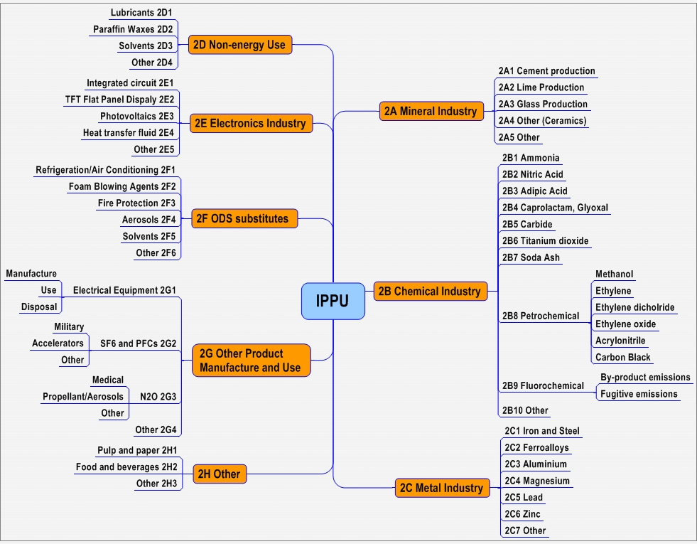

Slide 11
IPPU Gases (CO2, CH4, N2O, HFCs, PFCs, SF6 and NF3)
A wide variety of gases:
CO₂, CH₄, N₂O
HFCs, PFCs, SF₆
Other halogenated gases
Ozone/aerosol precursors (e.g., NMVOCs)
H₂O and gases controlled by the Montreal Protocol (e.g., CFCs, HCFCs) are not included
Under the UNFCCC, non-Annex I Parties:
should report CO₂, CH₄ and N₂O
are encouraged to report HFCs, PFCs, SF₆ and precursors
Inclusion of F-gases is important because of their high global warming potential (GWP), substantial use in industrial processes and in households, significant opportunities for GHG abatement

Slide 12
2A: Mineral Industry
Transformation of carbonate-contained compounds – limestone, dolomite, etc. (CaCO3, MgCO3, Na2CO3)
CO2 Emissions
Code | Category | Default EF
2A1: | Cement Production | 0.51 t CO2/t clinker
2A2: | Lime Production | 0.75 t CO2/t lime
2A3: | Glass Production | 0.20 t CO2/t glass
2A4: | Other Process Uses of Carbonates
2A4a: | Ceramics | Chapter 2.5
2A4b: | Other Uses of Soda Ash | 0.41 t CO2/ t soda ash
2A4c: | Non Metallurgical Magnesia Production | 0.52 t CO2/t magnesite
2A4d: | Other
2A5: | Other

Slide 13
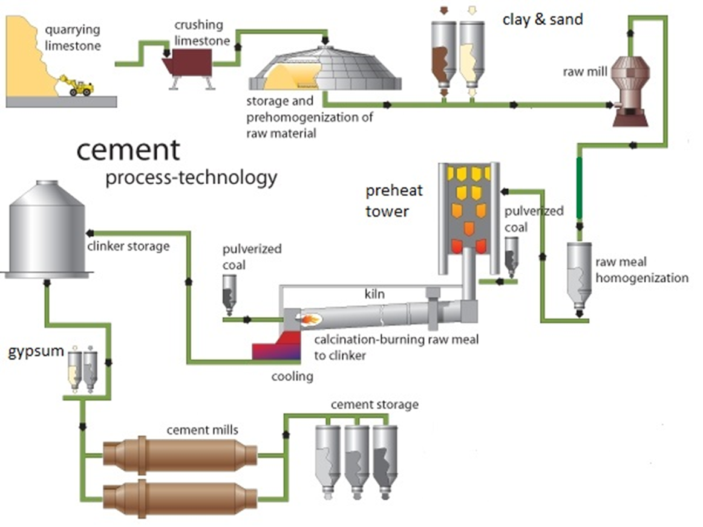
2A1: Cement production
Calcination: CaCO3 +(Heat) = CaO+CO2 (IPPU)
Combustion: Coal/Gas+O2=CO2 +(Heat) (Energy)
Image: applied from DCMAC: http://www.dscrusher.com/solutions/production-line/sand-cement-cogeneration-production-line.html (as of March, 1 , 2015)

Slide 14
CO₂ from Cement Production (Tier 1)
CO2 Emissions = AD clinker production x EF clinker
CO2 Emissions = [Σ(M_{c,i} x C_{Cl,i}) – Im + Ex] x EF_{Clc}
M_{c,i} - mass of cement produced of type i, tonnes
C_{Cl,i} - clinker fraction of cement type i, fraction
Im - imports for consumption of clinker, tonnes
Ex - exports of clinker, tonnes
EF_{Clc} - emission factor for clinker, tonnes CO₂/tonne clinker
Default EF_{Clc} = 0.52 tonnes CO₂/tonne clinker
(corrected for cement kiln dust (CKD))

Slide 15
CO₂ from Cement Production (Tier 1)
To estimate clinker production:
National-level data should be collected on:
Cement production by type (Portland, masonry, etc.)
Clinker fraction by cement type
If detailed information on cement type is not available, multiply total cement production by:
Default Ccl = 0.75 (if blended/‘masonry’ is much)
Default Ccl = 0.95 (if all is essentially ‘Portland’)
Data should be obtained on the amount of clinker imported and exported

Slide 16
CO₂ from Cement Production (Tier 2)
Tier 2 includes a correction addition for emissions associated with Cement Kiln Dust (CKD) not recycled to the kiln which is considered to be ‘lost’ and associated emissions are not accounted for by the clinker:
CO2 Emissions = M_{cl} x EF_{cl} x CF_{CKD}
CFCKD = 1 + (Md / Mcl) * Cd * Fd * (EFc / EFcl)
CFCKD - emissions correction factor for CKD, dimensionless
Md - weight of CKD not recycled to the kiln, tonnes
Mcl - weight of clinker produced, tonnes
Cd - fraction of original carbonate in the CKD (i.e., before calcination),
fraction
Fd - fraction calcination of the original carbonate in the CKD, fraction
EFc - emission factor for the carbonate, tonnes CO2/tonne carbonate
EFcl - emission factor for clinker uncorrected for CKD, tonnes CO2/
tonne clinker (i.e., 0.51)

Slide 17
CO₂ from Cement Production (Tier 3)
Limestones and shales (raw materials) also may contain a proportion of organic carbon (kerogen); other raw materials (e.g., fly ash) may contain carbon residues, which would yield additional CO2 when burned
Detailed plant-level data on the carbonate raw materials is needed

Slide 18
2B: Chemical Industry
Code | Category | Default EF
 |  | CO2 | N2O | CH4
2B1: | Ammonia Production | X
2B2: | Nitric Acid Production |  | X
2B3: | Adipic Acid Production |  | X
2B4: | Caprolactam, Glyoxal and Glyoxylic Acid Production |  | X X X
2B5: | Carbide Production SiC CaC2 | X X |  | X
2B6: | Titanium Dioxide Production | X
2B7: | Soda Ash Production | X

Slide 19
2B: Chemical Industry
Code | Category | Default EF
 |  | CO2 | CH4 | F-gases
2B8: | Petrochemical and Carbon Black Production
2B8a: | Methanol | X | X
2B8b: | Ethylene | X | X
2B8c: | Ethylene Dichloride and Vinyl Chloride Monomer | X X | X
2B8d: | Ethylene Oxide | X | X
2B8e: | Acrylonitrile | X | X
2B8f: | Carbon Black | X | X
2B9: | Fluorochemical Production
2B9a: | By-product Emissions |  |  | X
2B9b: | Fugitive Emissions |  |  | X

Slide 20
2B1: Ammonia Production
CO₂ associated with urea production & use:
1996 GL: all these emissions were implicitly included in CO₂ from Ammonia Production
2006 GL: CO₂ recovered in the ammonia production process for urea production should be deducted from CO₂ emissions from 2B1 Ammonia Production
CO₂ emissions from urea use/incineration should be reported in the category where they occur, e.g.:
Use of urea-based catalysts (Energy – Road Transport)
Urea application to agricultural soils (AFOLU)
Incineration of urea-based products (Waste)
Thus, now, proper account can be taken for urea produced in ammonia plants

Slide 21
2C: Metal Industry
Code | Category | CO2 | CH4 | F-gases
2C1: | Iron and Steel Production | X | X
2C2: | Ferroalloys Production | X | X
2C3: | Aluminium Production | X |  | X
2C4: | Magnesium Production | X |  | X
2C5: | Lead Production | X
2C6: | Zinc Production | X
2C7: | Other

Slide 22
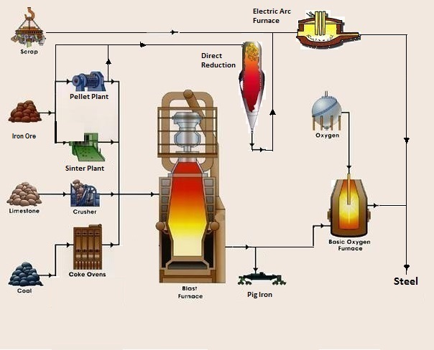
Image: applied from MetalPass http://www.metalpass.com/metaldoc/paper.aspx?docID=251 (as of March, 1 , 2015)
Coke production: (Energy)
Coal + (Heat) = Coke + Carbon Dioxide
Iron Production: + Iron Ore = Iron + Carbon Dioxide (IPPU)
Coke
Combustion: + Oxygen = Carbon Dioxide + (Heat) (IPPU)

Slide 23
2C1: CO₂ from Iron and Steel Production (Tier 1)
CO₂ emissions from Iron & Steel production:
CO2 Emissions = Σ(AD_{i} x EF_{i})
AD_{i} - quantity of material i, tonnes
EF_{i} - emission factor for production of material i, tonnes CO₂/tonne material i produced
Material i | Default EF | Global average default EF for Steel
 | tonne CO2/tonne material i
Crude steel from Basic Oxygen Furnace | 1.46 | 1.06
Crude steel from Electric Arc Oxygen Furnace | 0.08
Crude steel from Open Hearth Furnace | 1.72
Pig iron not converted to steel | 1.35 | (If activity data on steel production for each process is not available, multiply total steel production by this EF)
Direct reduced iron | 0.70
Sinter | 0.20
Pellet | 0.03
Coke Oven (should be reported in Energy) | 0.56

Slide 24
2C1: CO₂ from Iron and Steel Production (Tier 2)

Slide 25
2C3. Aluminium production – PFCs Emissions
Tier 1 uses technology-based default EFs for 4 main production technologies: Centre-Worked Prebake (CWPB), Side-Worked Prebake (SWPB), Horizontal Stud Søderberg (HSS) and Vertical Stud Søderberg (VSS)
Tier 2 based on direct measurements of PFCs for 4 technologies and 2 different methods: Slope and Overvoltage (relationship between anode effect and performance)

Slide 26
2D: Non-Energy Products from Fuels and Solvent Use
GHG emissions from use of non-energy products (lubricants, waxes, greases, solvents) other than:
- combustion for energy purposes;
- use as feedstock or reducing agent;
- incineration of waste oils/lubricants with/without energy recovery (Energy/Waste Sector).
A small proportion of non-energy products oxidises during use
Focus on direct CO₂ emissions and substantial NMVOC/CO emissions which eventually oxidise to CO2 in the atmosphere
Code | Category | CO2 | NMVOC, CO
2D1: | Lubricant Use | X
2D2: | Paraffin Wax Use | X
2D3: | Solvent Use |  | X
2D4: | Other (asphalt production and use) |  | X

Slide 27
2E: Electronics Industry
Code | Category
2E1: | Integrated Circuit or Semiconductor
2E2: | TFT Flat Panel Display
2E3: | Photovoltaics
2E4: | Heat Transfer Fluid
2E5: | Other
Gases: CF4, C2F6, C3F8, c-C4F8, c-C4F8O, C4F6, C5F8, CHF3, CH2F2, nitrogen trifluoride (NF3),
sulfur hexafluoride (SF6)
Electronics industry:
several advanced electronics manufacturing processes utilise fluorinated compounds for plasma etching silicon containing materials, cleaning reactor chambers, and temperature control. The specific electronic industries include semiconductor, thin-film-transistor flat panel display (TFT-FPD), and photovoltaic (PV) manufacturing

Slide 28
2F: Fluorinated Substitutes for ODS
Code | Category | HFCs | PFCs
2F1: | Refrigeration and Air Conditioning | X | X
2F1a: | Refrigeration and Stationary Air Conditioning | X | X
2F1b: | Mobile Air Conditioning | X | X
2F2: | Foam Blowing Agents | X | X
2F3: | Fire Protection | X | X
2F4: | Aerosols | X | X
2F5: | Solvents | X | X
2F6: | Other Applications | X | X

Slide 29
2F: Fluorinated Substitutes for ODS
Applications or Sub-applications - major groupings of current and expected usage of the ODS substitutes
Actual emissions vs. Potential emissions (2006 vs.1996)
Prompt emissions (within 2 years) and Delayed emissions
Bank – total amount of substances contained in existing equipment, chemical stockpiles, foams, other products not yet released to the atmosphere (+ExIm)
Approaches:
Emission Factor (a) and Mass-balance (b)
Tier 1 and Tier 2

Slide 30
Actual emissions vs. Potential emissions
The 2006 IPCC Guidelines provide with methods for estimating actual emissions of ODS substitutes in contrast to potential emissions approach (1996 IPCC Guidelines) taking into account the time lag between consumption of ODS substitutes and emissions.
Potential emissions approach assumes that all emissions from an activity occur in the current year (manufacture + import - export - destruction), ignoring the fact they will occur over many years, thus estimates may become very inaccurate
Example. A household refrigerator emits little or no refrigerant through leakage during its lifetime and most of its charge is not released until its disposal, many years after production. Even then, disposal may not entail significant emissions if the refrigerant and the blowing agent in the refrigerator are both captured for recycling or destruction
Use of actual emissions allows to:
accurately estimate emissions of ODS substitutes
proper address emission reductions of abatement techniques

Slide 31
Bank
Emissions
Exports of
Gas
Imports of Gas
Imports of
Exports of Gas
Bank of Gas in
Gas in
in Equipment
Equipment
Equipment
Manufacture of
Gas

Slide 32
Bank
Where delays in emission occur, the cumulative difference between the chemical that has been consumed in an application and that which has already been released is known as a bank (refrigeration and air conditioning, fire protection, closed-cell foams).
Example. Blowing agent still present in foamed products which may have already been land-filled is still part of the bank, since it is chemical which has been consumed and still remains to be released.
Estimating the size of a bank in an application is typically carried out by evaluating the historic consumption of a chemical and applying appropriate emission factors. It is also sometimes possible to estimate the size of bank from a detailed knowledge of the current stock of equipment or products.
Example. In mobile air conditioning - the automobile statistics may be available providing information on car populations by type, age and even the presence of air conditioning. With knowledge of average charges, an estimate of the bank can be derived without a detailed knowledge of the historic chemical consumption, although this is still usually useful as a cross-check.

Slide 33
..it is good practice to consider the number and relevance of sub-applications, the data availability, and the emission patterns…for rigorous emissions estimates, inventory compilers are likely to favour estimating emissions for each sub-application separately.. (Tier 2)

Slide 34
2F: Sub-applications

Slide 35
2F: Chemicals and blends

Slide 36
2F: Blends

Slide 37
2F: Tiers / Approaches and Data

Slide 38
2F4 / 2F5: Solvents / Aerosols
For prompt emissions (solvents, aerosols):
GHG Emissions = St*EF + St-1*(1-EF)
S – quantity of chemical sales in current and previous year t, t-1
EF = 1 for two years (100%), default EF - 0.5/0.5

Slide 39
2F2: Foams Blowing Agents
Open foams (GHG immediate release):
GHG Emissions = Mt
Mt - total HFC used in manufacturing new open-cell foam in year t, tonnes
Closed foams (GHG delayed release):
GHG Emissions = Mt*EFFYL+ Bankt*EFAL + DLt – RDt
Mt - total HFC used in manufacturing new closed-cell foam in year t
EFFYL - first year loss emission factor
Bankt - HFC charge blown into closed-cell foam manufacturing between
year t and year t-n
EFAL - annual loss emission factor
DLt - decommissioning losses or remaining losses of chemical at the end of
RDt - HFC emissions prevented by recovery and destruction

Slide 40
2F2: Closed foams: Emission Factors

Slide 41
2F1: Refrigeration/Air Conditioning
Tier 2b (Mass-Balance):
Emissions = Annual Sales of New Refrigerant – Total Charge of New Equipment+
+ Original Total Charge of Retiring Equipment - Amount of Intentional Destruction
in estimating Annual Sales of New Refrigerant, Total Charge of New Equipment, and Original Total Charge of Retiring Equipment, inventory compilers should account for imports and exports of both chemicals and equipment.
Tier 2a (Emission factor):
Emissions = Econtainers + Echarge + Elifetime + Eend-of-life
Econtainers = RM* c/100
Echarge = M * k/100
Elifetime = B *x/100
Eend-of-life = M * p/100 * (1- n/100)
EFs: c, k, x, p, n

Slide 42
2F1: Refrigeration/AC: Emission Factors

Slide 43
Need help? No worries! The IPCC Software will work out!
The IPCC Inventory Software enables you to estimate actual emissions even if you do not have historic data.
(!) But you need to have the data on:
Year of introduction of chemical
Domestic production of chemical in current year
Imports of chemical in current year
Exports of chemical in current year
Growth rate of sales of equipment that uses the chemical

Slide 44
Example 1. In Country X the production of a specific refrigerant (HFC-143a) is 800 tonnes with an additional 200 tonnes in imported equipment, making a total consumption of 1 000 tonnes in 2005.
Based on the consumption pattern and knowledge of the year of introduction of the refrigerant (1998), it can be estimated that emissions will be 461 tonnes assuming the development of banks over the previous seven years.
The bank in 2005 is estimated at 3 071 tonnes.

Slide 45
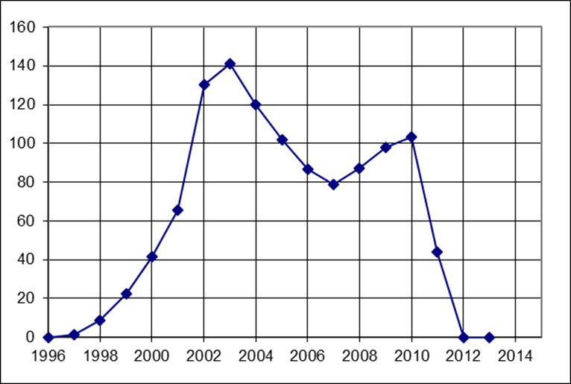
Example 2. Country X imported only the refrigerant HFC-134a in years 1997-2003 (there is no production and export). Based on the consumption pattern, it can be estimated that in 2013 there were no GHG emissions taking into account development of the bank and emissions from retired equipment

Slide 46
2G: Other Product Manufacture and Use
Code | Category | Code | Category
2G1 | Electrical Equipment | 2G2c | Other
2G1a | Manufacture | 2G3 | N₂O from Product Uses
2G1b | Use | 2G3a | Medical Applications
2G1c | Disposal | 2G3b | Propellant for Pressure
2G2 | SF₆/PFCs from Other Uses | 2G3c | Other
2G2a | Military Applications | 2G4 | Other
2G2b | Accelerators
SF6 and PFCs: electrical equipment: gas insulated switchgear and substations (GIS), gas circuit breakers (GCB), high voltage gas-insulated lines (GIL), gas-insulated power transformers (GIT). Military equipment: ground and airborne radar, avionics, missile guidance systems, ECM (Electronic Counter Measures), sonar, amphibious assault vehicles, other surveillance aircraft, lasers, SDI (Strategic Defense Initiative), stealth aircraft. PFCs for cooling electric motors, e.g., in ships and submarines. Cosmetic and medical applications, research particle accelerators.
N2O: Medical applications, Auto-racing, Propellant in aerosol products

Slide 47
IPPU Activity Data: Cross-Checks

Slide 48
IPPU Activity Data: Cross-checks / QC
The CO2 completeness check
Feedstock balance check
Potential emissions approach for estimating HFCs, PFCs, or SF6

Slide 49
IPPU Activity Data: Data Collection – RAC
Where to get:
Regulation for phase-out of CFCs and HCFCs
Government Statistics
Refrigerant Manufacturers and Distributors
Disposal Companies
Import/Export Companies
Manufacturer Association
Marketing Studies
What to get:
schedule of phase out for charging of brand new equipment and for servicing
number of equipment disposed of for each type of application
all virgin refrigerants sold for charging new equipment and for servicing in the different sectors
equipment produced on a national level using HFC refrigerants (for all sub-applications)
number of equipment using HFCs (imported and exported)
HFC refrigerants recovered for re-processing or for destruction
average equipment lifetime
initial charge of systems

Slide 50
IPPU Activity Data: Confidentiality
Data providers might restrict access to information because
it is confidential, unpublished, or not yet finalized
Find solutions to overcome their concerns by:
explaining the intended use of the data
agreeing, in writing, to the level at which it will be made public
identifying the increased accuracy that can be gained through its use in inventories
offering cooperation to derive a mutually acceptable data sets
and/or giving credit/acknowledgement in the inventory to the data provided

Slide 51
Conclusion
Diversity of sources and gases in the IPPU Sector
Difficult to exhaustively include all sources & gases
At least major sources & gases (key categories) must be included
Care to Activity Data:
Difficult to collect activity data (input/output data, plant-specific data)
Data allocation and Double-counting
Confidential data from private companies
Various opportunities for GHG abatement
Capture and abatement at plants (N₂O destruction at nitric acid production plants)
Recovery at the end of product’s life and subject to either recycled or destroyed (HFCs in refrigerators)

Slide 52

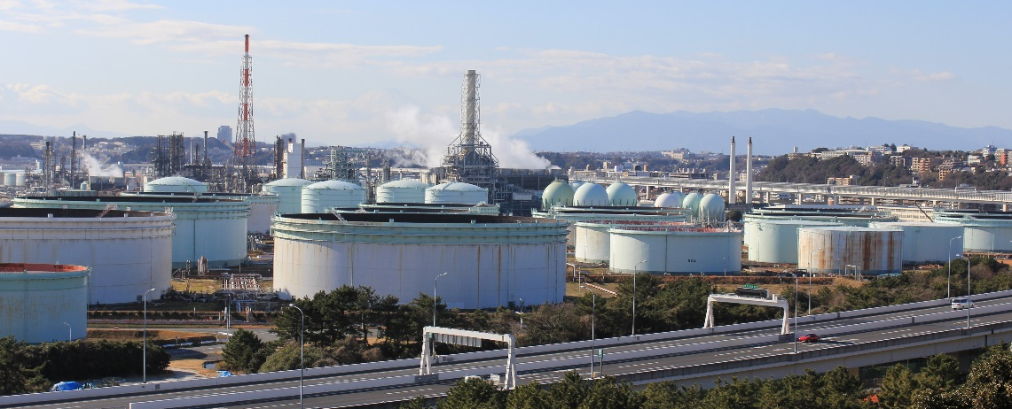
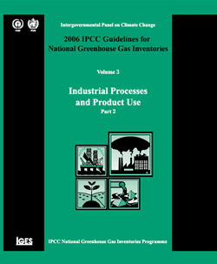
Thank you for your attention!
Any questions?

