Slide 1
IPCC Inventory Software
Africa Regional Workshop on the Building of Sustainable National
Greenhouse Gas Inventory Management Systems, and
the use of the 2006 IPCC Guidelines for National Greenhouse Gas Inventories
24-28 April 2017, Swakopmund, Namibia
Pavel Shermanau, IPCC TFI TSU

Slide 2
Introduction
The IPCC Inventory Software implements the 2006 IPCC Guidelines for National Greenhouse Gas Inventories. It can also be used for reporting under the 1996 IPCC Guidelines
  it allows countries to utilise the improvements in the methodologies and default values since 1996
The IPCC launched the IPCC Inventory Software in 2012
The latest officially published version is available from:
http://www.ipcc-nggip.iges.or.jp/software/index.html

Slide 3
IPCC Inventory Software
The IPCC Inventory Software can assist inventory compilers in using the IPCC Guidelines
  stand alone software with modest hardware requirements
  data entry in worksheets following the 2006 IPCC Guidelines for ease-of-use
  it can be used for the whole inventory or just individual categories
  allows different parts of the inventory to be developed simultaneously
  can be used when reporting 1996 or 2006 Guidelines
  provides default data from the 2006 IPCC Guidelines but gives users the flexibility to use their own country-specific information
  includes Uncertainty and Key Category Analysis
  aids QA/QC
  outputs in non-Annex I National Communications format
  FREE!

Slide 4
Software Functions
Administration functions: Country, Users, Years
Contains default data
QA/QC: Uncertainty analysis, KCA, Reference Approach
Worksheets for data entry
Data Managers: Land Types and Livestock
Data Export
and
Import
Data Archive

Slide 5
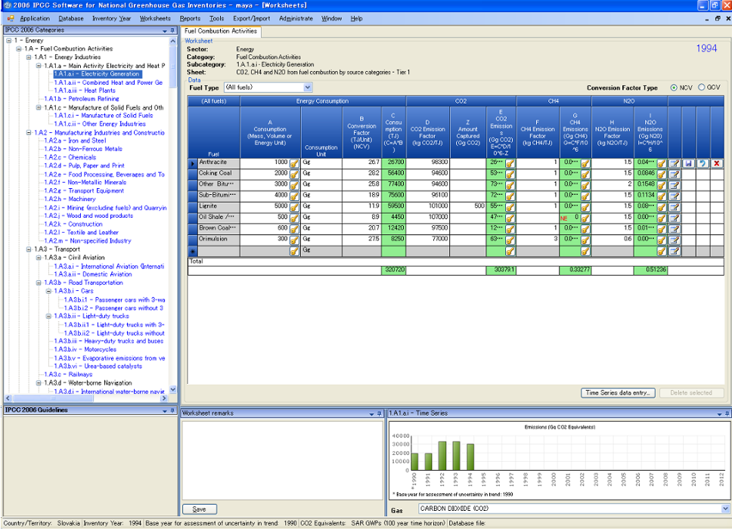
Main menu
Category: Energy
Data Entry
Hierarchical list of categories
Worksheet-based calculations follow 2006 Guidelines
Time Series Display
Status bar contains useful information
e.g. country, inventory year

Slide 6
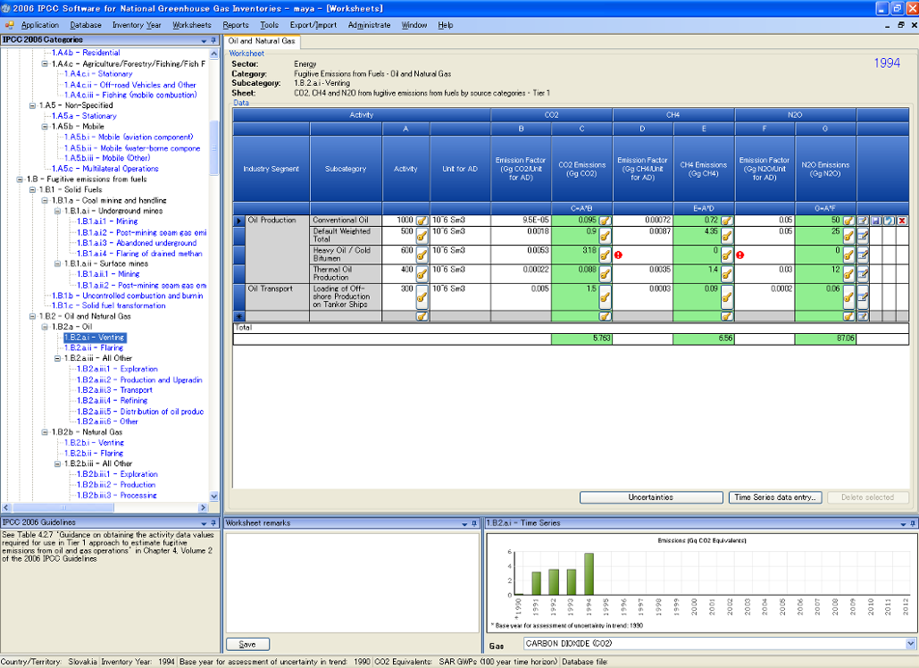
Notation Keys
Available
Defaults Available: can be over-written with country specific data
Uncertainties
Time Series Data Entry

Slide 7
Reports
Report | Level | Contents
Summary | 1.A.1 | Emissions
Short summary | 1.A | Emissions
Sectoral | 1.A.1.a.ii (most disaggregated level) | Emissions
Background | 1.A.1.a.ii (most disaggregated level) | Activity data Emissions
Note: All reports can be exported as MS Excel file

Slide 8
NAI Reporting Table
The IPCC Inventory Software follows the format of Tables in Annex to Decision 17/CP.8 (Guidelines for the preparation of National Communications from Parties not included in Annex I to the Convention)
Main Menu
    → Export/Import
        → NAI Reporting Tables

Slide 9
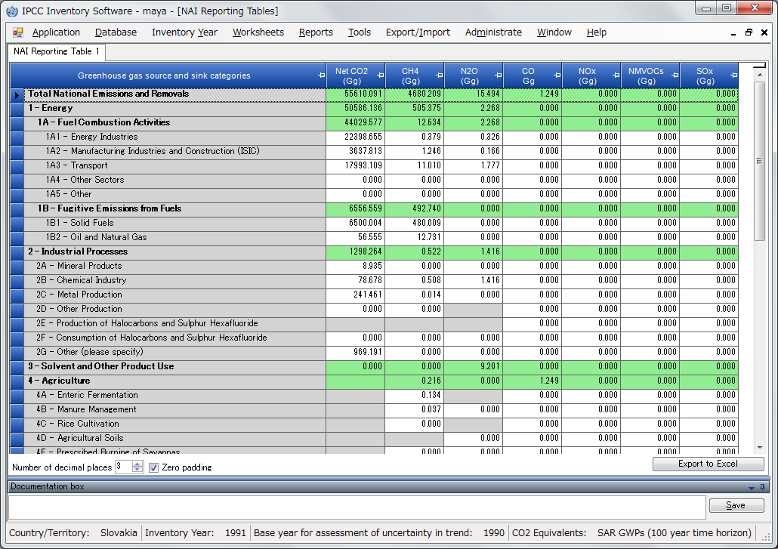
NAI Reporting Table
Export → NAI Reporting Table

Slide 10
Tools
  Uncertainty analysis
  Key category analysis
When all values are entered in the worksheet for each sector, these analysis can be performed by following steps:
Main Menu
    → Export/Import
        → Uncertainty Analysis
        or Key Category Analysis
  click “Refresh” button

Slide 11
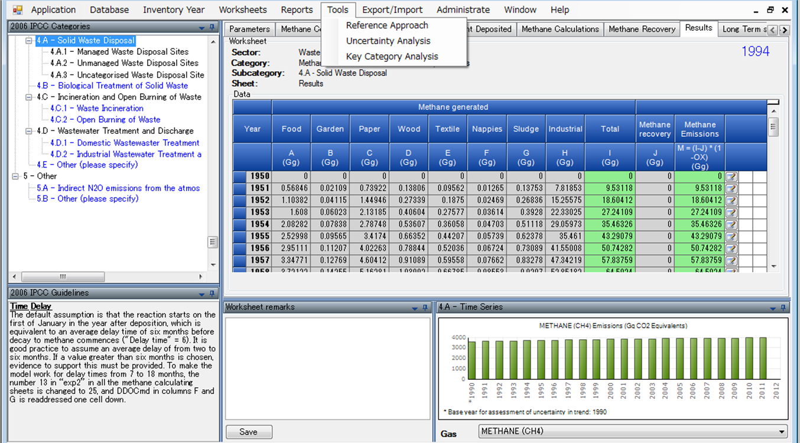
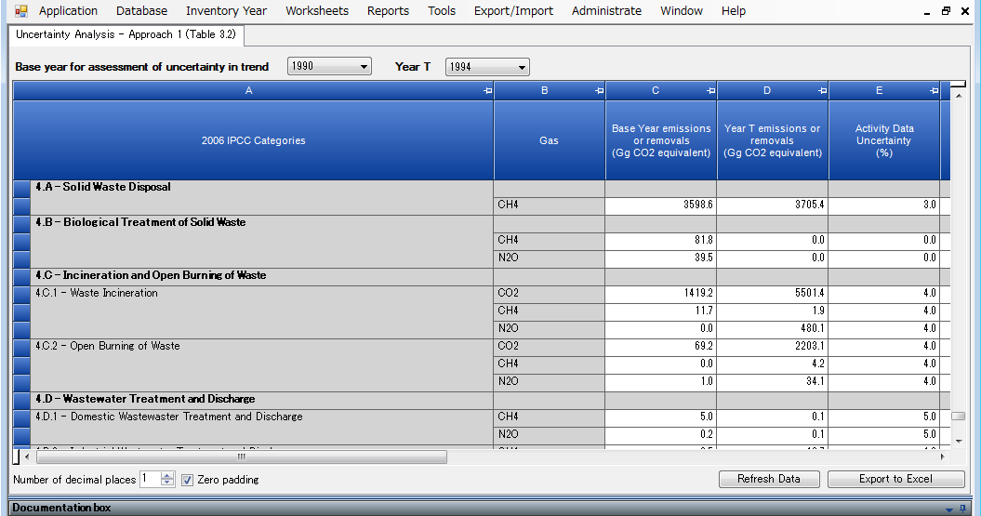
Tools
Click Tools – Uncertainty Analysis
Click “Refresh Data” to perform analysis

Slide 12
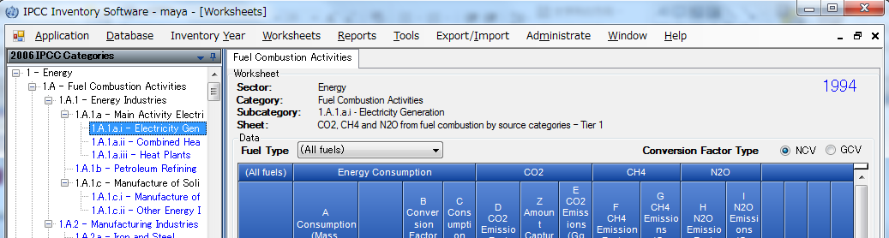
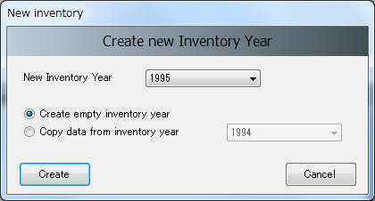
Other basic operations - Year
Inventory Year
Create New year
Select year

Slide 13
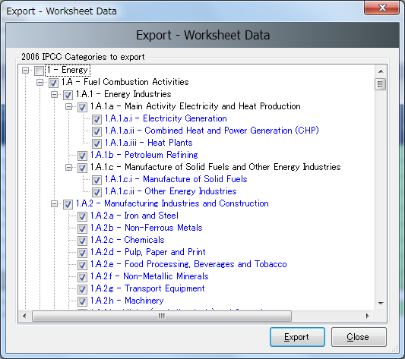
Other basic operations - Export
Export/Import worksheet data as XML file format.
In this example,
Worksheet data for category 1A for year 1994 will be exported.

Slide 14
Multiple Users
Project manager
Sectoral Experts(s)
Distribute updated DB (MDB file)
Distribute empty database
(MDB file)
Compile Sector 1
PM: Initialise Database
PM: Update Database
Compile Sector 2
Combine Databases
(XML File)
Combine Databases
(XML File)
Database
Compile Sector n
Checks, Uncertainty, KCA
Using XML file will reduce the chances of losing or overwriting the database unintentionally
Prepare Outputs

Slide 15
Support
The TSU is supporting the IPCC Inventory Software:
  Help Desk E-mail: ipcc-software@iges.or.jp
  Web Forum: https://discussions.zoho.com/ipccinventorysoftware/
  please, read the User Manual
TSU will maintain the IPCC Inventory Software and is planning to implement the following:
  Tier 2 methods
    with Version 2.54, the Software implements Tier 2 methods in the 2006 IPCC Guidelines for most categories under Energy, IPPU and Waste Sectors
    Livestock categories are under development
  Wetlands Supplement

Slide 16

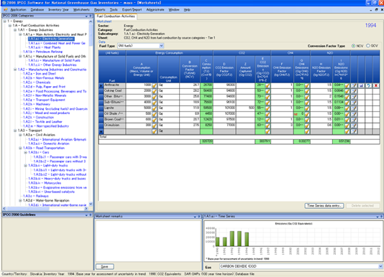
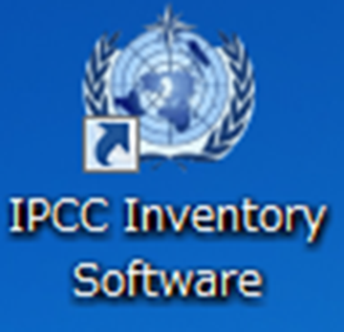
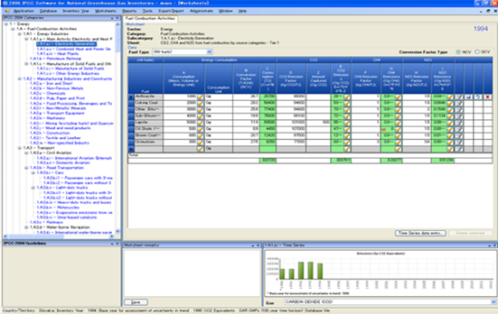
Thank you for your attention!
Any questions?

