Slide 1
IPCC Emission Factor Database (EFDB)
Africa Regional Workshop on the Building of Sustainable National
Greenhouse Gas Inventory Management Systems, and the use of the 2006
IPCC Guidelines for National Greenhouse Gas Inventories
Swakopmund, Namibia
24-28 April 2017
Baasansuren Jamsranjav, IPCC TFI TSU

Slide 2
IPCC EFDB
Library of emission factors/parameters and other relevant data with background documentation
Default values from IPCC Guidelines
Data from peer-reviewed scientific papers
Data from other publications (government reports, industry studies etc.)
http://www.ipcc-nggip.iges.or.jp/EFDB/
Communication platform to share data/information on emission factors and other parameters that can be used to estimate greenhouse gas (GHG) emissions/removals

Slide 3
IPCC EFDB
Evolves dynamically: data proposals (e.g. voluntary submissions from inventory compilers and researchers) and data collection efforts (e.g. expert meetings to collect data)
Open to any data proposals
Data proposals are considered by Editorial Board of the EFDB for inclusion in the database
Criteria for inclusion of new data: robustness, applicability and documentation
Annual meeting of the Editorial Board: to consider data proposals and discuss how to enhance/improve the EFDB
Summary of the meetings available at TFI website
http://www.ipcc-nggip.iges.or.jp/meeting/meeting.html

Slide 4
Growing importance
In the context of National Communications from non-Annex I Parties, the Consultative Group of Experts (CGE) recommended
Improvement of data quality by enhancement of the sharing of country-specific emission factors through the IPCC Emission Factor Database and among Parties not included in Annex I to the Convention (FCCC/SBI/2011/5/Rev.1)
New reporting guidelines on annual inventories for Annex I Parties
If Annex I Parties lack country-specific information, they could also use EFs or other parameters provided in the IPCC Emission Factor Database, where available, provided that they can demonstrate that those parameters are appropriate in the specific national circumstances and are more accurate than the default data provided in the 2006 IPCC Guidelines (Decision 24/CP.19)

Slide 5
How to access EFDB
Two types of applications are available
Web application (http://www.ipcc-nggip.iges.or.jp/EFDB/main.php)
Offline application (e.g. DVD)
The web application is the core of this system. New data will be made available in the web application first
The offline application works with MS Access MDB file, which contains the copy of the web database
Can be used on a stand-alone PC
Available for download at the EFDB website
http://www.ipcc-nggip.iges.or.jp/EFDB/main.php

Slide 6
Web application

Slide 7
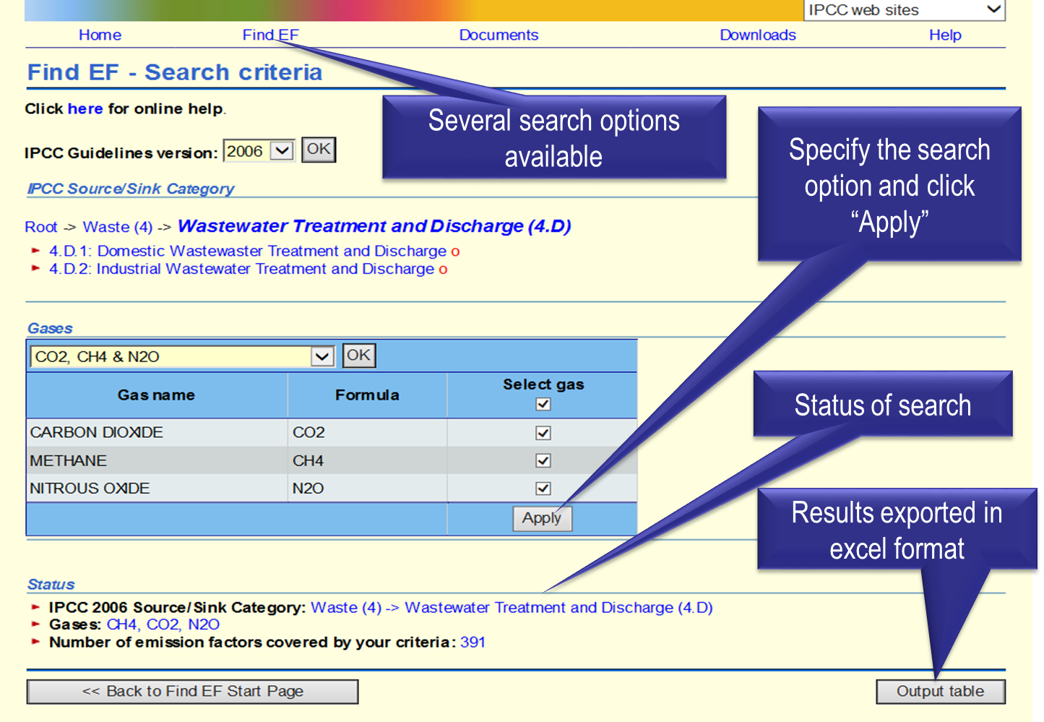
Data search

Slide 8
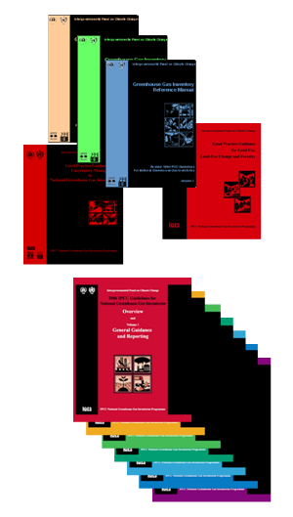
Populating EFDB
EFDB
Data Provider
Defaults
Accepted Data
Data
Data Meeting
Editorial Board (EB)
TSU
- Initial check of data proposals
- Collection of new data and preparation of data proposals
Data
Data

Slide 9
Criteria for inclusion of new data
Robust
Within the accepted uncertainty, the value is unlikely to change if there was repetition of the original measurement programme or modelling activity
Applicable
An emission factor can only be applicable if the source and its mix of technology, operating and environmental conditions and abatement and control technologies under which the emission factor was measured or modeled are clear and allow the user to see how it can be applied
Documented
Access information to the original technical reference must be provided to evaluate the robustness and applicability as described above

Slide 10
Enhancement and improvement of EFDB
Populating the EFDB
Expert meetings to collect data have been organized since 2008
Focus on specific sectors/categories with the aim to identify, select and approve data for inclusion into the EFDB
Attended by both data providers and EB members
Literature search (e.g. peer-reviewed papers)
User-interface is being further improved

Slide 11
Thank you
http://www.ipcc-nggip.iges.or.jp/
ipcc-efdb@iges.or.jp

