Slide 1
National GHG Inventories: Scope & General Principles and 2006 IPCC Guidelines and relationship to earlier IPCC Guidelines
Africa Regional Workshop on the Building of Sustainable National Greenhouse Gas Inventory Management Systems, and the use of the 2006 IPCC Guidelines for National Greenhouse Gas Inventories
Swakopmund, Namibia, 24-28 April, 2017
Andrej Kranjc, Head of IPCC TFI TSU

Slide 2
What are national GHG inventories?
Estimates of all emissions (and removals) of particular gases from given sources from a defined region in a specific period of time
Here we are dealing with
Greenhouse Gases
National Estimates
Annual Estimates

Slide 3
Why?
Scientific Understanding
Input to models
Understand link between environmental pollution and effects to sources of pollution
Policy
Before any pollution problem can be efficiently controlled we need to know the sources and amounts emitted
To help develop cost-effective policy
To monitor progress towards policy goals
To inform the public

Slide 4
DPSIR
DRIVERS
e.g. Industry & transport
RESPONSES
e.g. Adaptation and Mitigation – sea defences, public transport, emission controls, fuel switching
PRESSURES
e.g. emissions
STATE
e.g. ambient concentrations
IMPACT
e.g. temperature, sea level, storm intensity
Notes:
？

Slide 5
Why do we need inventory guidelines?
Any international agreement to limit climate change must set emission limits/targets/aims and monitor progress in an open and transparent way
Currently, most national emissions can only be estimated, not measured and so we need a consensus on the best way of doing this.
Cannot measure all sources (e.g. road transport would be impractical; Remote sensing techniques not available)
To do this we need reliable, generally accepted methods and guidelines

Slide 6
How?
Make estimates based on parameters associated with emission rates
CO₂ from fuel depends on carbon in fuel
CO₂ proportional to amount of fuel burnt
Changes on stocks of carbon in forests give emissions (or removals) of CO₂
Where:
E = Emission
EF = Emission Factor
AD = Activity Data

Slide 7
Credibility
As these are estimates we need to ensure they are credible
Verification
Checking that the numbers are correct – that they reflect the true emissions
Validation
Checking that the estimates are compiled correctly in the way they are supposed to be done
Needs standard methodologies and inventory management

Slide 8
Good Practice (1)
Assists countries in producing inventories that are accurate in the sense of being neither over- nor underestimates so far as can be judged, and in which uncertainties are reduced as far as possible
Gives a way to manage uncertainties
Identifies main “KEY” categories to focus resources
Documentation provides transparency

Slide 9
Good Practice (2)
IPCC Good Practice gives guidance on
Approaches to Data Collection
Uncertainty Evaluations
Key Category Analysis and Methodological Choice
Recalculations
Quality Control and Quality Assurance
Review
Documentation

Slide 10
Good Practice (3)
Supports the development of inventories that are:
Transparent
Documented
Consistent over time
Complete
Comparable
Assessed for uncertainties
Subject to quality control and assurance
Efficient in the use of resources available to inventory agencies
In which uncertainties are gradually reduced as better information becomes available

Slide 11
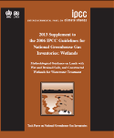

Evolution
Guidelines have evolved from 1996 to 2006
Development of Good Practice Guidance (GPG) was a major step forward
Complete, consistent, comparable, transparent, and accurate inventories taking account of available resources
Major change was from 1996 LUCF to GPG LULUCF
2006 Guidelines [2.5 years work, 250 authors]
Have 4 sectors
Have improved methods and default data
Cover more greenhouse gases and methods
Integrate GPG
Require similar resources
Do not pre-empt accounting choices
The best globally applicable methods
2013
+

Slide 12
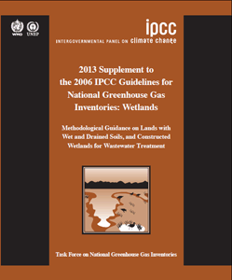
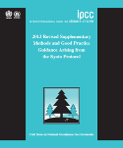
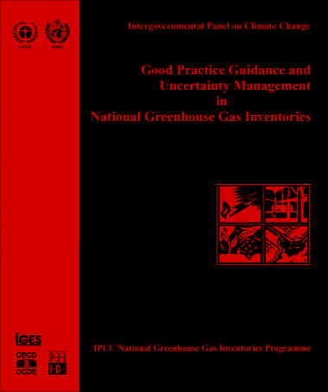

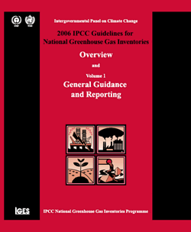
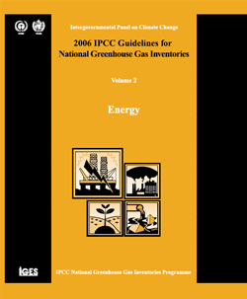
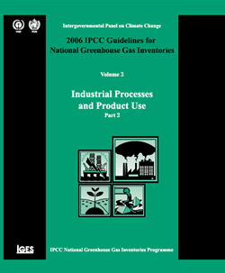
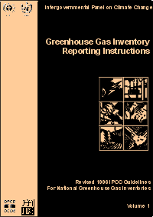
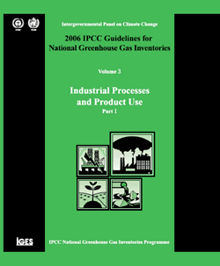
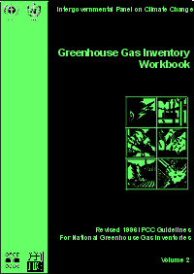
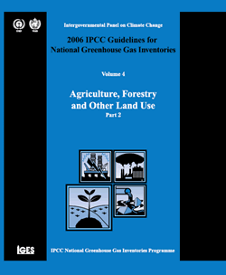
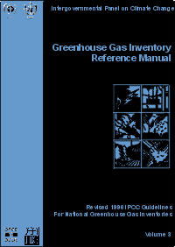
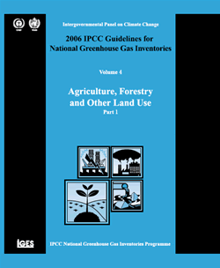
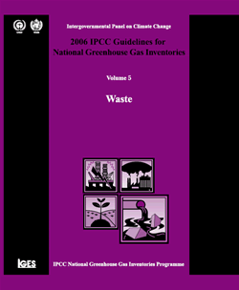
IPCC Inventory Guidelines
New Supplementary Guidance in 2013
＋
Non-Annex I Parties are encouraged to use GPGs.
Annex I Parties must use from 2015
Non-Annex I Parties should use 1996 Guidelines. (Annex to Decision 17/CP.8)
GPG2000 (non-LULUCF)
GPG2003 (LULUCF)
2006 IPCC Guidelines
1995 IPCC Guidelines
Revised 1996 IPCC Guidelines
Actually, 2006 Guidelines are being used by more and more Non-Annex I Parties.
Revision/Update by the IPCC

Slide 13
2006 Guidelines being used by NAI Parties
At the 42nd Session held in June 2015, the Subsidiary Body for Implementation (SBI) of the UNFCCC concluded under the agenda item on “Reporting from Parties not included in Annex I to the Convention”:
“The SBI noted the requests from non-Annex I Parties for further technical support aimed at improving their domestic capacity to facilitate continuity in meeting reporting requirements through training on the use of the 2006 IPCC Guidelines for National Greenhouse Gas Inventories, …” (FCCC/SBI/2015/10, paragraph 29)

Slide 14
Methodological approaches unchanged
In General:
Energy
Based on carbon content of fuel
Fugitive (leaks) use emission factors
Industrial Processes
Based on chemistry of process
Some use mass balance of product used
Land Use
Stock changes ⇒ Emissions/Removals
Inputs (e.g. growth) - outputs (e.g. decay, harvest)
Total Stock at end minus Total stock at beginning
Agriculture
Based on understanding of processes
Waste
Tracks carbon (fossil & biogenic) in waste

Slide 15
GPG and Sectoral Guidance
Good Practice inventories are defined as “those that contain neither over- nor under-estimates so far as can be judged, and in which uncertainties are reduced as far as is practical”
GPG retains consistency with Revised 1996 Guidelines and is updated and expanded in the 2006 Guidelines
Approaches to Data Collection

Slide 16
“New” gases in 2006 Guidelines – Sources Identified in 2006 Guidelines
By-product & fugitive emissions
 | Electronics Industries | Magnesium production | Halogenated Compounds Production | GWP in TAR | GWP in AR4
nitrogen trifluoride (NF₃) | ✔ |  | ✔ | ✔ | ✔
trifluoromethyl sulphur pentafluoride (SF₅CF₃) |  |  | ✔ | ✔ | ✔
halogenated ethers (e.g. C₄F₉OC₂H₅, CHF₂OCF₂OC₂F₄OCHF₂, CHF₂OCF₂OCHF₂) | ✔ |  | ✔ | ✔ | ✔
CF₃I, CH₂Br₂, CHCl₃ |  |  | ✔ | ✔ | ✔
CH₂Cl_{2,} CH₃Cl |  |  | ✔ | ✔ | ✔
C₃F₇C(O)C₂F₅ |  | ✔ | ✔
C₄F₆, C₅F₈, c-C₄F₈O | ✔ |  | ✔

Slide 17
Direct & Indirect Emissions: CO₂ and N₂O
2006 Guidelines “CO₂ Emissions”
2006 Guidelines “CO₂ Emissions” do not include this automatically
2006 Guidelines give methods to calculate this
2006 Guidelines includes ALL NH₃ & NO_{x} Emissions

Slide 18
Estimation of Actual Annual Emissions
In the 1996 Guidelines and Good Practice Guidance for a few sources, the simplest methodology estimates a “potential emission” rather than the actual annual emission.
This “potential emission” assumes all the emissions from an activity occur in the current year, ignoring the fact they will occur over many years (e.g. methane emissions from waste in landfills occurs over decades as the decay processes take place).
In the 2006 Guidelines, simple default methods estimate emissions when they occur, thus removing the need for potential emissions.
The removal of potential emission estimates also allows the emission reductions of abatement techniques to be properly estimated and ensures that the Tier 1 methods are compatible with higher tier methods. The areas where this occurred are:
Actual emissions of fluorinated compounds
Methane from landfills

Slide 19
“New” Guidance in 2006 Guidelines

Slide 20
New Methodology Reports
The TFI has developed two additional methodology reports in response to the invitations from UNFCCC:
2013 Supplement to the 2006 IPCC Guidelines for National Greenhouse Gas Inventories: Wetlands (Wetlands Supplement)
To fill gaps in the coverage of wetlands and organic soils in the 2006 IPCC Guidelines
2013 Revised Supplementary Methods and Good Practice Guidance Arising from the Kyoto Protocol (KP Supplement)
To update and augment the existing Chapter 4 of the GPG- LULUCF
The Wetlands Supplement and KP Supplement were adopted/accepted by the IPCC Plenary at its 37th Session (IPCC 37) in Batumi, Georgia, 14-18 October 2013, and published on the TFI website in February 2014.
Wetlands Supplement
KP Supplement
http://www.ipcc-nggip.iges.or.jp/public/wetlands/index.html
http://www.ipcc-nggip.iges.or.jp/public/kpsg/index.html

Slide 21
2019 Refinement to the 2006 IPCC Guidelines (1)
TFB at its 26th Meeting in Ottawa (28-29 August 2014) concluded that:
2006 IPCC Guidelines provide a technically sound methodological basis of national greenhouse gas inventories; however,
to maintain their scientific validity, certain refinements may be required, taking into account scientific and other technical advances that have matured sufficiently since 2006.

Slide 22
2019 Refinement to the 2006 IPCC Guidelines (2)
IPCC decided at its 44th session in Bangkok on 17-20 October 2016 to prepare a Methodology Report to refine the 2006 IPCC Guidelines with the following format and title:
The format should be one single Methodology Report comprising an Overview Chapter and five volumes following the format of the 2006 IPCC Guidelines for National Greenhouse Gas Inventories (2006 IPCC Guidelines).
The title of the Methodology Report should be “2019 Refinement to the 2006 IPCC Guidelines for National Greenhouse Gas Inventories”.

Slide 23
2019 Refinement to the 2006 IPCC Guidelines (3)
Will be completed in May 2019.
Aim:
to provide an updated and sound scientific basis for supporting the preparation and continuous improvement of national GHG inventories;
not to revise the 2006 IPCC Guidelines, but update, supplement and/or elaborate the 2006 IPCC Guidelines where gaps or out-of-date science have been identified.
Format and Structure:
Same as the 2006 IPCC Guidelines (= Overview Chapter and 5 Volumes) so as to make it easier for inventory compilers to use the 2019 Refinement in conjunction with the 2006 IPCC Guidelines.
The 2019 Refinement will not replace the 2006 IPCC Guidelines. It should be used in conjunction with the 2006 IPCC Guidelines.

Slide 24
2019 Refinement to the 2006 IPCC Guidelines (4)
To be developed by approximately 200 authors from all over the world.
Three review stages are planned:
Expert Review of First Order Draft: Dec 2017 – Feb 2018
Government/Expert Review of Second Order Draft: Jul – Sep 2018
Government Review of Final Draft: Jan – Mar 2019
Scope and outline approved by the IPCC at its 44th Session (Oct 2016, Bangkok, Thailand) are included in Decision IPCC/XLIV-5.
http://www.ipcc.ch/meetings/session44/p44_decisions.pdf
Other relevant documents:
Report of the Scoping Meeting (Aug 2016, Minsk, Belarus) http://www.ipcc-nggip.iges.or.jp/meeting/meeting.html
Presentations at a side event during COP-22 (Nov 2016, Marrakech, Morocco) http://www.ipcc-nggip.iges.or.jp/presentation/presentation.html
Overall schedule of production of IPCC Reports including 2019 Refinement http://www.ipcc.ch/activities/pdf/ar6_schedule.pdf#page=2

Slide 25
Various Tools – Supporting Materials
Emission Factor Database (EFDB)
IPCC Inventory Software
Primer for 2006 IPCC Guidelines
Reports of Expert Meetings
http://www.ipcc-nggip.iges.or.jp/EFDB/
http://www.ipcc-nggip.iges.or.jp/software/index.html
http://www.ipcc-nggip.iges.or.jp/support/support.html
http://www.ipcc-nggip.iges.or.jp/meeting/meeting.html

Slide 26
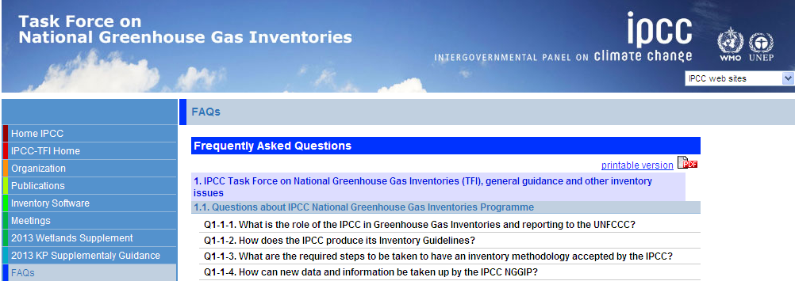
Various Tools – FAQ Website
Answers to frequently asked questions (FAQs) such as:
Q1-3-2: “What is the difference between accuracy and precision? Does uncertainty assessment relate to both?”
Q2-10: “According to the IPCC Guidelines CO₂ Emissions from the combustion of biomass are reported as zero in the Energy sector. Do the IPCC Guidelines consider biomass used for energy to be carbon neutral?”
Continuously updated
For example, a new set of Q&As on the use of 2006 Guidelines in other areas has been recently added following a relevant expert meeting.
http://www.ipcc-nggip.iges.or.jp/faq/faq.html

Slide 27
Summary
Emission inventories have several uses.
They help understand problems and are a key to policy development as well as reporting and monitoring progress towards targets.
They are estimates and cannot be completely measured.
Inventory management and “good practice” is as important as the emission estimation itself.
The same basic methodological approaches are used from 1996 Guidelines, through GPG 2000 & GPG LULUCF to 2006 Guidelines.
The 2006 Guidelines maintain, with improvements, the methods of earlier guidelines and integrate GPG.
The 2006 Guidelines provide improved guidance in some areas, more and improved default data.
Wider coverage of gases
Additional sources covered
All estimates are now of actual annual emissions (“potential” emissions not needed)
Categories simplified and clarified in some areas
The 2006 Guidelines do not pre-empt accounting choices – all the information needed is retained.

Slide 28
Thank you!

